Slide 1
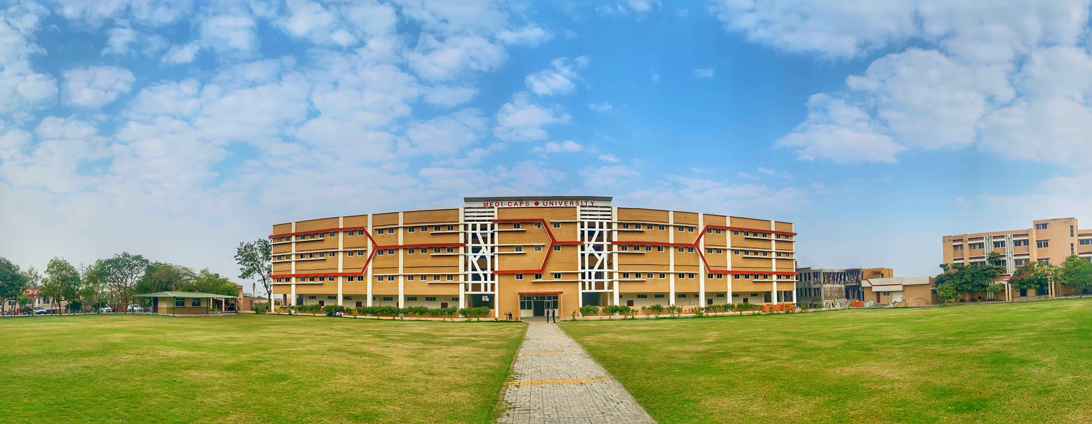

Engineering Physics (EN3BS05)
Mini Project
Van de Graff Generator
Submitted by:
Akshat Vijayvargiya 2001277
Kuldeep Dangi 2001281
Jay Baldwa. 2001318
Mrinal Maurya 2001349
Guided by:
Mrs. Bhawna Kshirsagar

Slide 2
Content
Objective of Mini Project
Introduction
Material/components required
Principle of working
Conclusion
Applications and limitations
Future scope
Reference

Slide 3
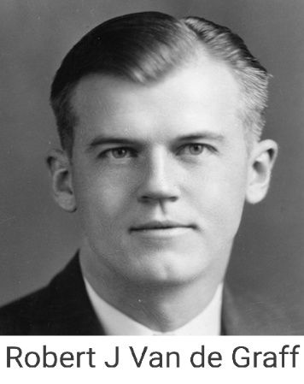
Objective:
To design a Van de Graff Generator and study it for understanding its principle and working.
Introduction
The first Van de Graf generator was invented in 1931 by an American physicist named Robert JemisonVan de Graff. He called the machine an electrostatic accelerator. This type of generator is able to produce extremely high voltages – some today can produce up to 20 million volts of static electricity! . The Van De Graff Generator is basically an electrostatic machine that can generate high voltages. A typical Van De Graf Generator consists of an insulating belt that transports electrical charge to a terminal. The charges that are sent on the belt are generated through a high voltage DC supply. These charges are collected in the inside of the terminal and transferred to its external surface. The method of charging is based on the triboelectric effect.

Slide 4
Triboelectric Effect:
The triboelectric effect (also known as triboelectric charging) is a type of contact electrification on which certain materials become electrically charged after they are separated from a different material with which they were in contact.
When two materials are rubbed together, a flow of electrons can take place depending on the triboelectric properties. When such a transfer occurs, the material that lost electrons will become positively charged and the one that gained electrons becomes negatively charged
Material/Components required:
Combs
C1 and C2 are two combs can be simply a stretched wire, or a sharp or serrated edge. Charges are “sprayed” on to and removed from the moving belt by “combs” situated adjacent to the rollers. Actual contact between the combs and the belt is not essential because of the high potential differences.
The lower comb is maintained at or close to earth potential and is a drain for negative charge, leaving the belt with positive charges that are carried up to the top comb.

Slide 5
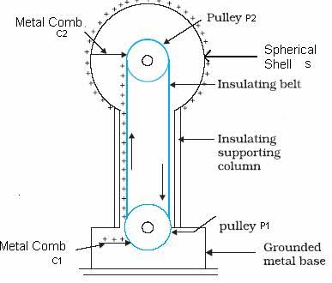
Belt
A flexible belt made from an insulating material and running continuously over two pulleys. As the roller rotates it maintains its positive charge, which causes the needle to spew negative charge onto the belt, which causes a small electric current to flow from ground and into the needle.
Pulleys
P1 and P2 are two pulleys made of different materials and connected through a flexible insulated belt. They are used to charge the belt. Pulley P2 is inside the conducting sphere and P1 is at the end of the column. P1 is connected to a motor or drive manually.

Slide 6
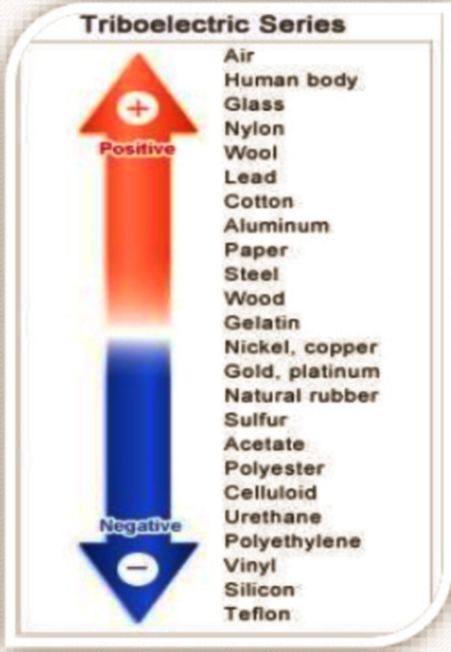
Insulating supporting column
The support column for the collecting sphere can be a simple PVC plastic rod or acrylic tube or a pair of acrylic strips with separators. Since the diameter of the collecting sphere determines the maximum p.d. (voltage) achievable, large spheres are mounted on taller columns to be more remote from the earth motor and control box.
Charging current
So long as the belt continues to move, the process continues, the drive (motor or manual) supplying the power to overcome the electrical repulsion between the charges collected on the sphere and those arriving on the belt.

Slide 7
Principle
The Van De Graff generator works simply on the principle of static electricity
1) The electric discharge takes place in air or gas at pointed conductors readily.
2) If a hollow conductor is in a contact with another conductor then the hollow conductor continuously accepts all the charge supplied by the other conductor irrespective of its growth in potential. This charge on the hollow conductor is transferred on its surface and is uniformly distributed on it.
Working Principle of The Generator
Let us consider a large spherical shell of radius R. If we place a charge of magnitude Q on such a sphere, the charge will spread uniformly over the surface of the sphere. The electric field inside the sphere is zero, and that outside the sphere is due to the charge Q at the center of the sphere. So, the potential outside is that of a point charge; and inside it is constant. We, thus, have:

Slide 8
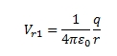
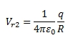
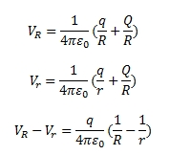
Potential inside conducting spherical shell of radius R carrying charge Q = constant and is as follows
Let us place a small sphere at the center of the large one such that the radius of the smaller sphere is r and the charge over its surface is q.
At the surface of the small sphere:
At the large spherical shell of radius R:
If we consider the total charges in the system, that is, q and Q, then the total potential energy due to the system of charges is:

Slide 9
Conclusion:
A Van de Graaff generator is a device for making lots of static electricity. Static electricity is made from extra charges stored some place so that they can’t move. Normally charges don’t like to collect in one place. They like to find opposite charges as partners and run away from particles with the same charge.
The generator makes static electricity the same way we do when we rub our feet on the carpet and then touch a doorknob. Inside the generator is a giant rubber band that rubs across a piece of felt, stealing its electrons. The rubber band then spins around and the electrons travel up to the big metal ball on top. If you have a hand on the metal ball, the electrons will go into you.
Generally, the stored charges on the Van de Graaff generator want to try to get into the ground. The earth is very big and the negatively charged particles (electrons) can get very far away from each other. If a metal ball, which is connected to the ground if brought near the generator, the charges will jump through the air from the generator to the ball.
If you touch the generator, all that electricity will go through your body giving you a big shock. It can actually be dangerous. You can be protected from the ground by standing on a piece of rubber or plastic. We say plastic and rubber are insulators since charges can’t travel through them very easily. When you touch the generator now, the charges can’t get to the ground. You are now filled up with electrons. The electrons don’t like each other and are trying to get as far away from each other as possibly. Usually this makes your hair stand up because it is filled with electrons that are repelling each other.

Slide 10
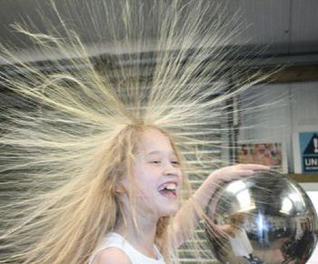
Applications
The Van de Graff generator was developed as a particle accelerator for physics research; its high potential is used to accelerate subatomic particles to great speeds in an evacuated tube. It was the most powerful type of accelerator of the 1930s until the cyclotron was developed.
The beam of these charged accelerated particles is used to trigger the nuclear reaction.
Accelerated particle beams are used to break atoms for various experiments in physics.
Van de Graff generators are still used as accelerators to generate energetic particle and X-ray beams for nuclear research and nuclear medicine.
In modern times, the application of Van De Graff generators is largely limited to academic purposes to demonstrate the practical aspects and concepts of electrostatic behavior of particles.
In medicine, such beams are used to treat cancer.

Slide 11
Limitations
Sparks from the Van de Graff are typically a few centimeters long, giving a voltage between 50,000 and 150,000 V.
It produces very low intensity of current as compared to voltage.
Maintenance and construction is costly and bulky.
For air, a maximum of 3 million volt can be generated as after that air will ionize.
It cannot accelerate neutral particles.
Future Scope
New research shows that the N95 masks used by health care workers to prevent the spread of COVID can be sterilized and recharged using a van de Graaff generator. This work may lead to a much larger supply of personal protective equipment for those most likely to be exposed to the virus
A Van de Graaf generator (metal ball) can safely charge a human body to 400,000 volts, allowing a mass spectrometer (instrument, right) to analyze ionized chemicals on a person’s body or breath.

Slide 12
Scientists have found a way to combine these Van de Graaff generators with a mass spectrometer to detect drugs, explosives, and other illicit materials on the human body.
The new method may be useful for security checkpoints at airports or other public places, where officers could quickly and easily determine whether a person has recently handled explosives or illicit drugs.
The method might help diagnose diseases characterized by certain chemicals in the breath, such as diabetes, or detect drugs or alcohol on the breath of suspects. The technique is fast, providing a readout within seconds.

Slide 13
Reference:
Physics N.C.E.R.T Text Book (12th)
Wikipedia
https://nationalmaglab.org/education/magnet-academy/watch-play/interactive/van-de-graaff-generator

Slide 14
Thank you

